Slide 1
Process control –Hyperdrive Project
Joachim Raffaele Bono Elise Høimyr Séverine Oppliger
Group D

Slide 2
OVERVIEW
This project utilizes the MQTT protocol for communication with the Anki Hyperdrive vehicle
It provides a graphical user interface (GUI) that allows users to interact with a remote-controlled vehicle.
It contains versions in both Python and Java. The overall features are the same in both languages, some features may differ slightly.
Both programs can run and interact with the same vehicle at the same time

Slide 3





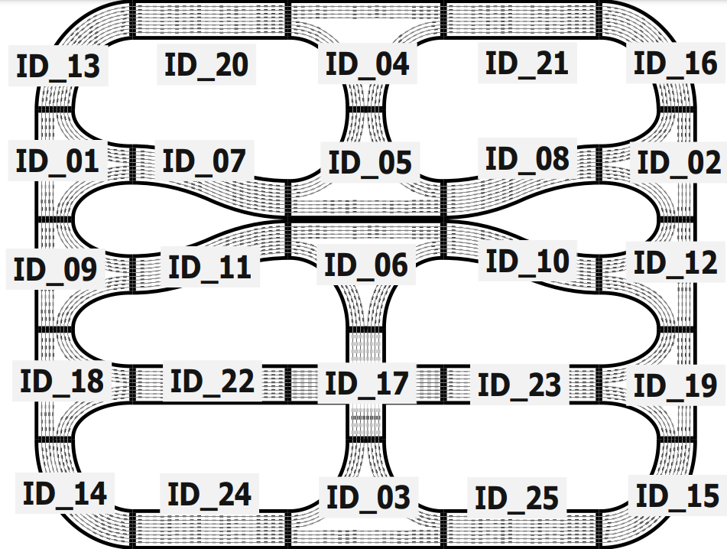






System overview
publication
MQTT broker
On
Off
MQTT
MQTT
MQTT
Emergency
MQTT
subscription

Slide 4
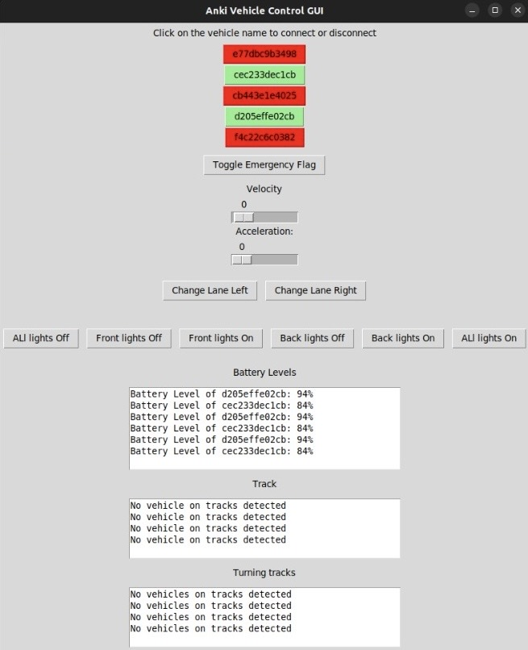
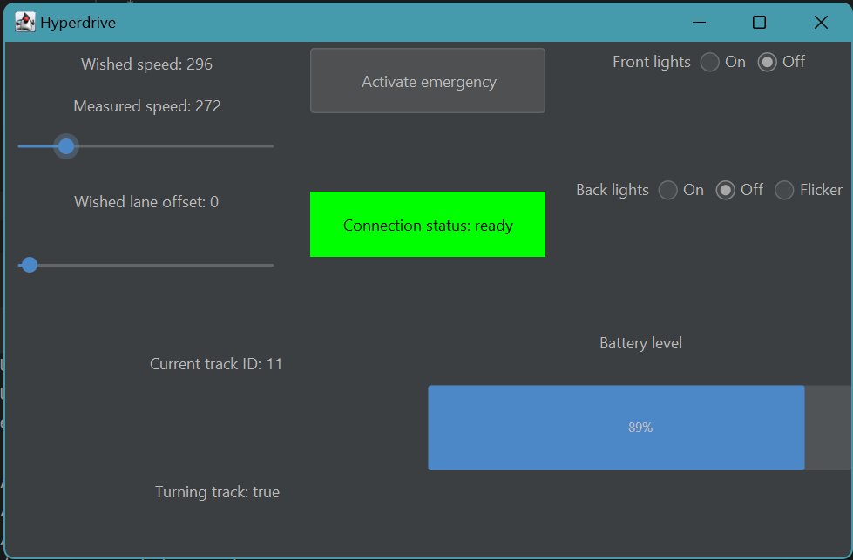

GRAPHICAL USER INTERFACE (GUI)
Python (uses Tkinter)
Java (uses Swing)

Slide 5
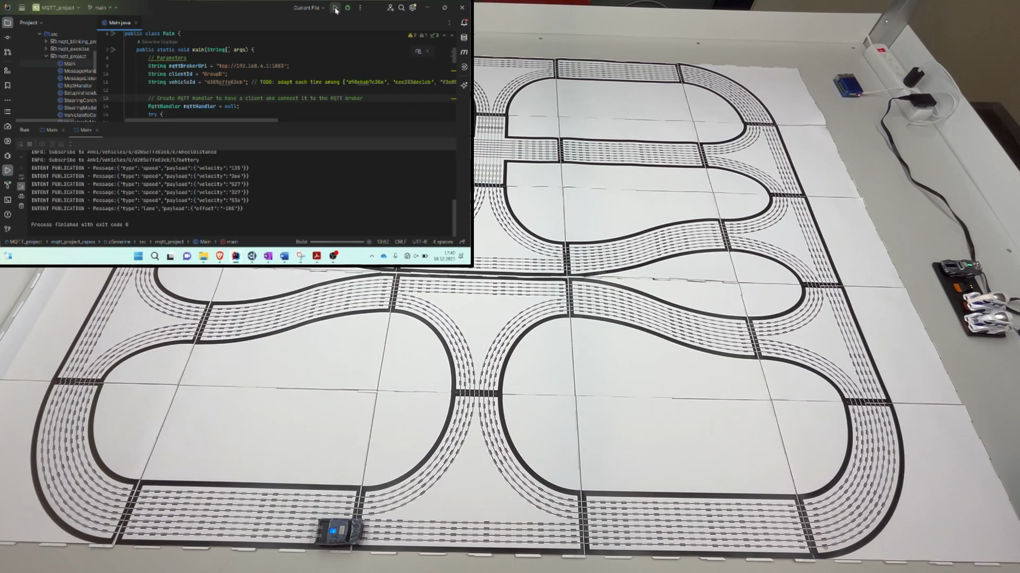
JAVA Demo

Slide 6
PYTHON Demo

Slide 7








Java Implementation (1/2) - Classes
Utilities
MqttHandler
MessageHandler
MessageListener
Manage communication between the application and the MQTT broker
Manage MessageListeners and handle incoming messages (store them in the appropriate MessageListener instance)
Recipient of the last message published in a given topic to which we are subscribed
Main
MVC architecture
Connect to vehicle through MQTT broker
Steering thread
SteeringModel
SteeringController
SetupVehicleManager
Control speed, lane offset, lights + (de)toggle emergency stop
Broker discovering ?
If no, «discover»: true
Vehicle among recognized vehicles ?
Connect vehicle
Is vehicle ready ?
View
VehicleInfoModel
VehicleInfoController
VehicleInfo thread
Retrieve info about connection status, measured speed, trackId, battery level + estimate if turning

Slide 8






Java Implementation (2/2) – MVC
Steering thread
Wished speed
Wished lane offset
Front lights / Back lights
Emergency status
On
Off
MQTT
Emergency
Observable
Observer
Model
Controller
View
VehicleInfo thread
Connection status
Measured speed
Turning status
Current track id
Battery level
MQTT
Observable
Observer

Slide 9
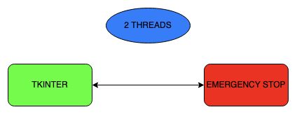
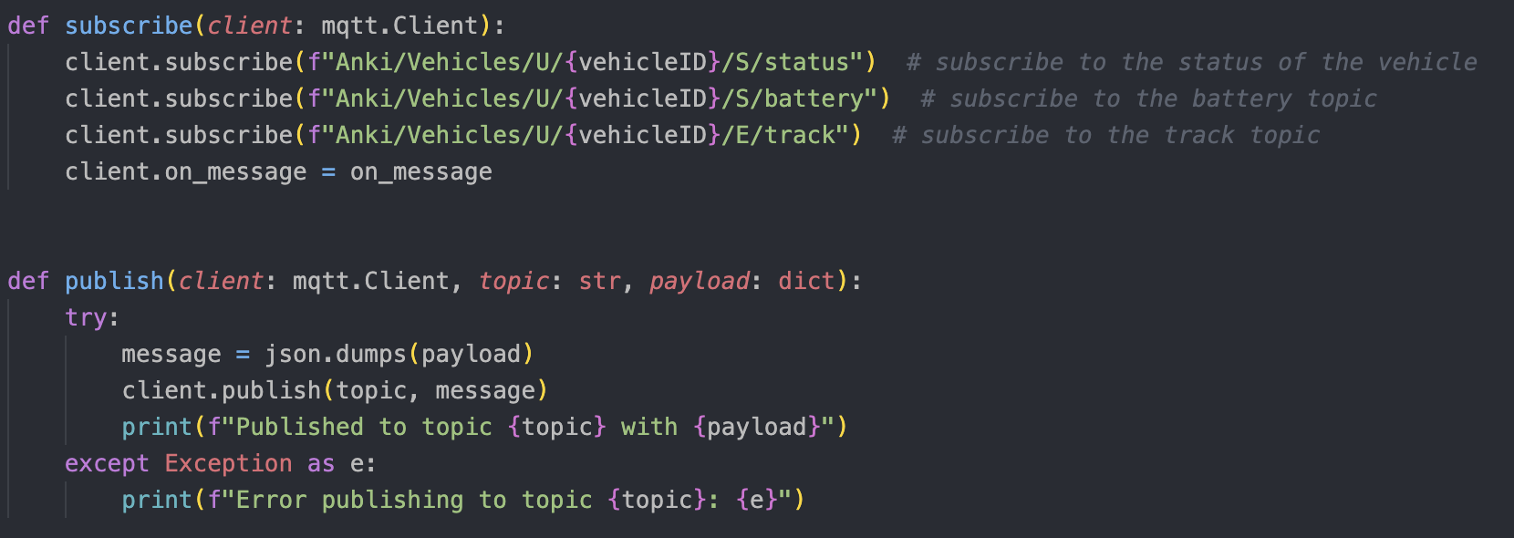
PYTHON Implementation (1/2)
Emergency flag
Select Vehicle from the list of vehicles available
Control:
Speed
Lanes
Lights
Tracks:
TrackID
Turn?
If the emergency flag is set to True, the vehicle stops and its lights blink to indicate an emergency
Example of a publish:
Threads:
The Tkinter thread takes care of creating the GUI and updating it accordingly
The Emergency stop thread takes care of the emergency stop process and checks if the emergency flag has been toggled

Slide 10





PYTHON Implementation (2/2)
Both threads are started
Run the program
List of available vehicles
Slider for speed
Button to switch lanes
Front lights / Back lights
Emergency flag control
Tracks
Battery level
Tkinter
On
Off
On
Off
Emergency
Emergency
Emergency
On
Off
Vehicle is stopped
Lights blink to indicate an emergency
Lights stop blinking
Vehicle resumes its activity
Emergency

Slide 11
Difficulties
GUI:
Sliders: action (publish) at each step while we move it (not only when the mouse is released)
→ fixed on Java but doesn’t work on Python
Battery status: is not really reliable (shows 80 when battery is fast empty and sometimes values are inconsistent)
Concurrent programming: no Java interaction with MQTT emergency topic
→ no external emergency activation detected
Emergency stop: resuming activity after the emergency stop requires to move the sliders once again (for Java and Python)
Identifying specific types errors in publishing

